Slide 1
Eyes on the Ground
A Project by:
Ryan Oberleitner
Ava-Li Baker
Chris Paez

Slide 2
Project Proposal
EOTG is a small tech startup based in Pittsburgh, Pennsylvania
EOTG is also the name of our flagship application
The application fills a need in the market for aggregated livestream content
EOTG will be a single platform that aggregates multiple livestream platforms onto a geographical map by which users can locate and view livestreams

Slide 3
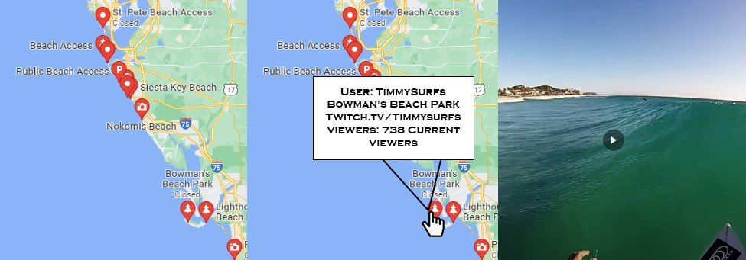
The Project
EOTG grabs data from other livestream platforms (Twitch.tv, Youtube.com. Vimeo.com, etc.)
EOTG grabs the metadata from these locations and sorts each stream by geographic location
The app then places markers on a map, allowing users to pick and choose by location
Aggregated Livestream list User selects specific stream User Views Livestream

Slide 4
Requirements
Goals -
Metrics
6 Months after rollout: 20,000 unique visitors per month. Average of one to two hours per day per visit
Participation – 6 months after rollout: 50-100 content contributors from most major western countries. 10-20 from smaller countries
Performance – Only 1 bug or crash per 10,000 hours viewed. Hardware and software upgrades as needed for the first 6 months, and routinely every 3 months afterwards.

Slide 5
Requirements
Technology -
Mobile Operating Systems : Apple, Android, and Windows
Servers: Web Server, Application Server, Database Server
Data -
Metadata from source livestreams
User and Contributor data
Application Data
Data grabbed from original source and embedded onto EOTG

Slide 6
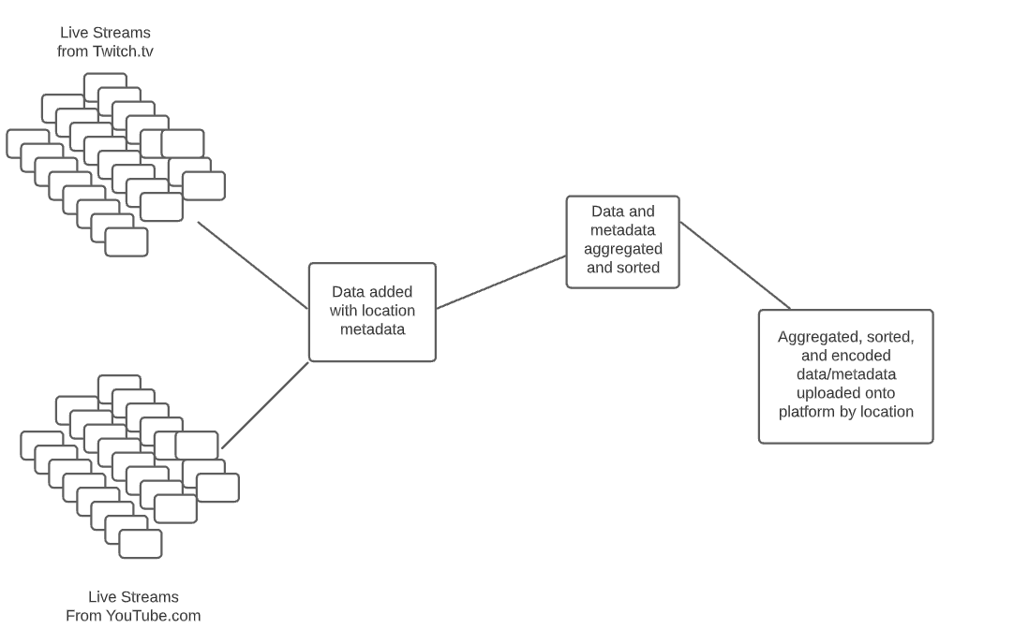
System Architecture

Slide 7
Development & Budget Analysis
Software and Resources
Hardware Components
Labor
Hosting
Liability
Conservative / Liberal Estimates of Net Revenue
Profit

Slide 8
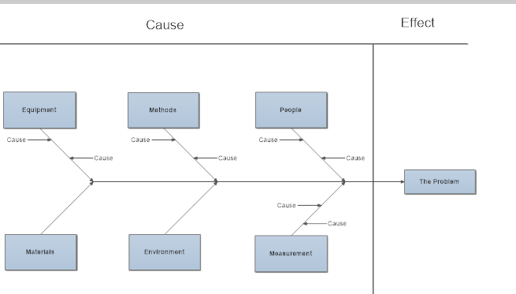
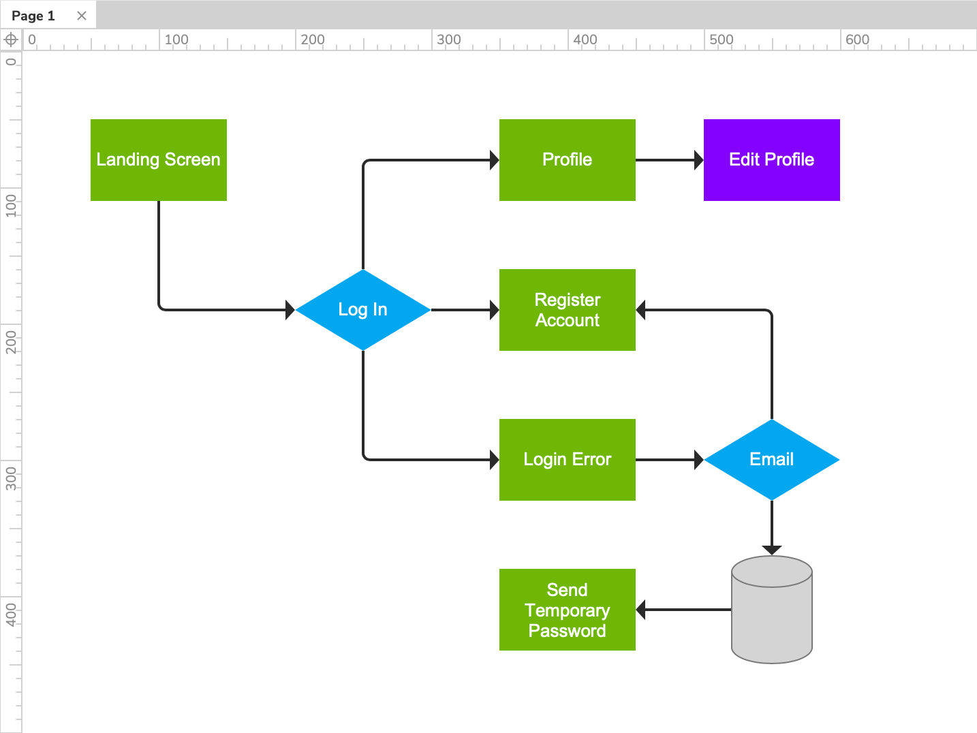
Tools & Techniques

Slide 9
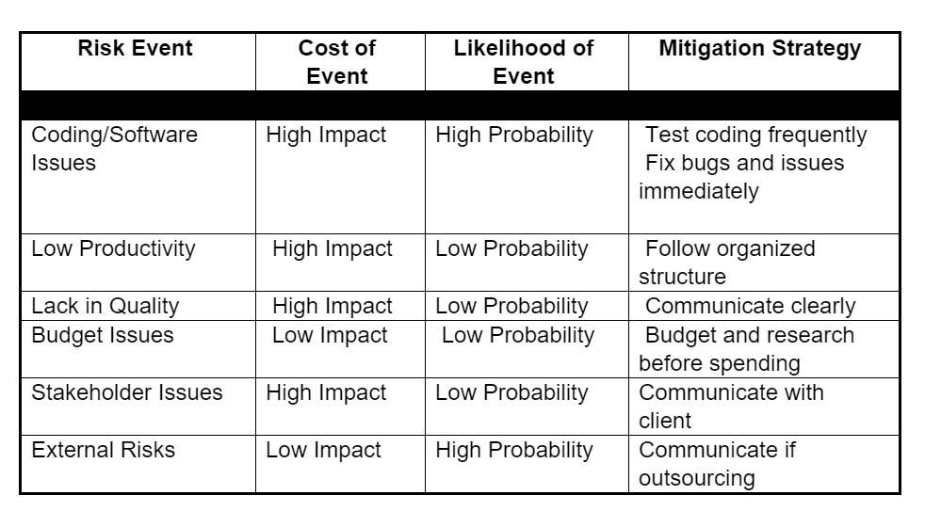
Risk Analysis

Slide 10
System Dependencies / Testing Requirements
Dependency
Testing
Portability
Version Control
Updates on a Regular Basis
Adoption Rate and Usage
Hardware
Software
Usability
Compatibility
Interface
Services
Performance

Slide 11
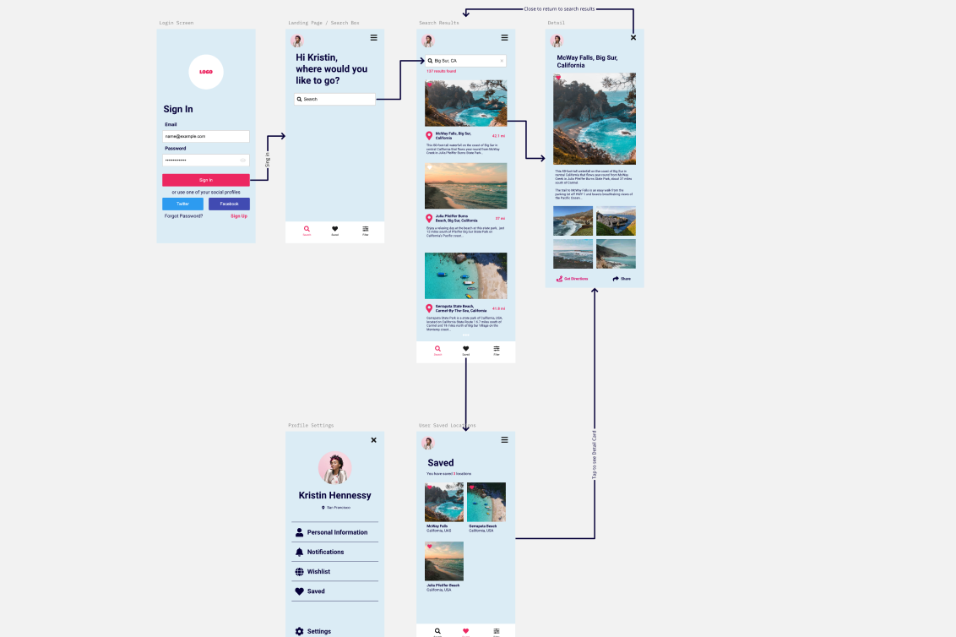
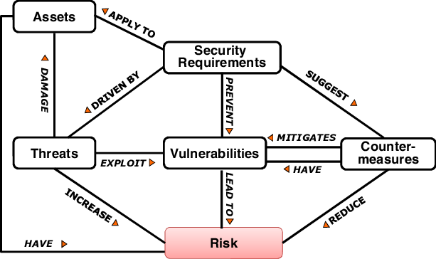
Operational Prototype

Slide 12
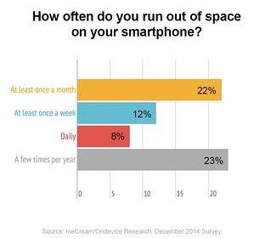
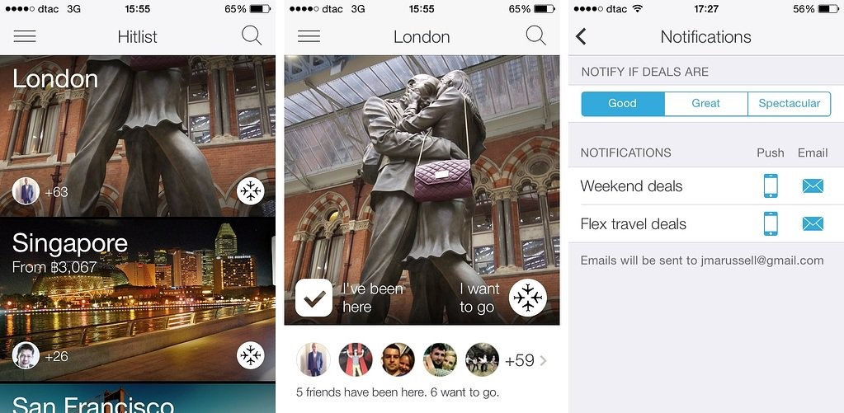
Design Constraints

Slide 13
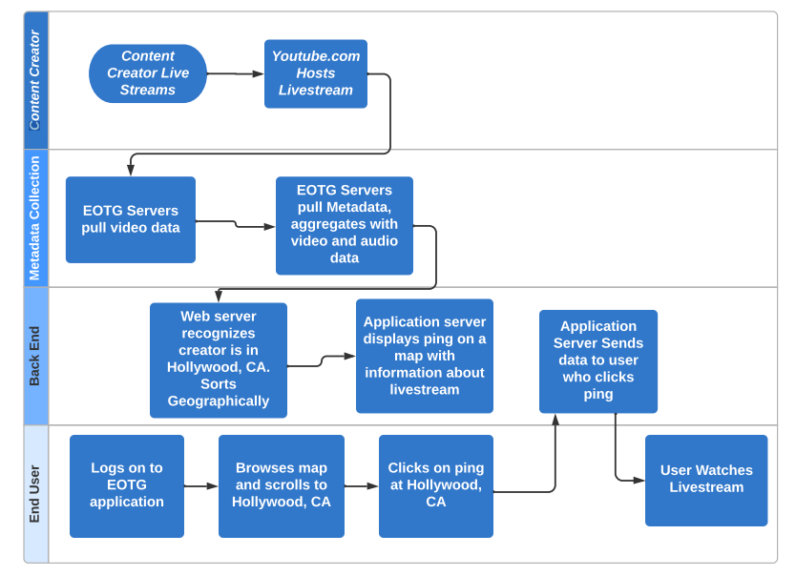
Use Case and Specification

Slide 14
Project Hand off Plan
Commercial/Contractual
Process
Data and Knowledge transfer
People

Slide 15
User guide
Expect 90% of users to able to easily navigate software upon first use
Tooltips
“How to” videos

